Slide 1
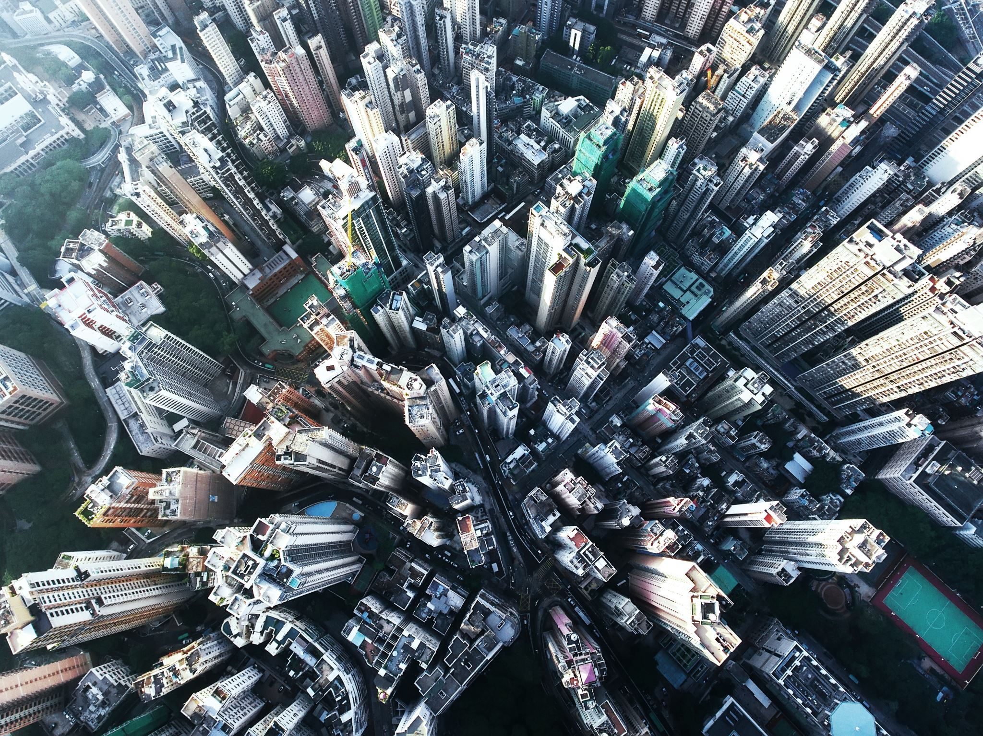

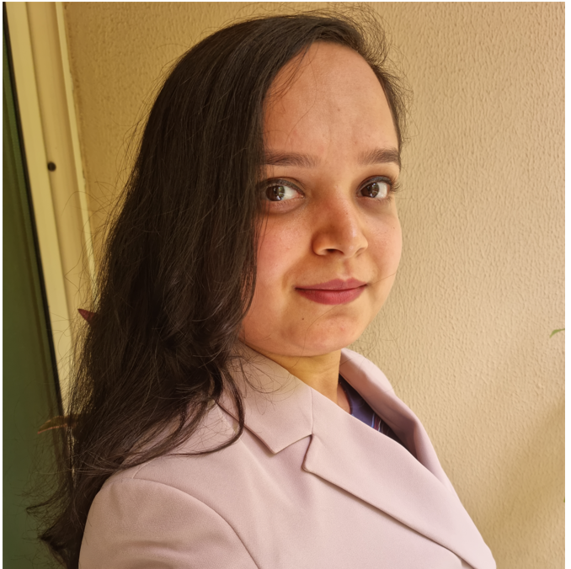
Real Estate of Dubai : prediction and trend-analysis
Contributors: Team Indigo Eagles
Deanne Fletcher
Relocation Consultant,
Intouch Relocations
Neha Singh
IT Specialist,
Kings College Hospital

Slide 2
Problem Statement
People are wondering if this is the right time to make an investment and will they be able to get proper returns in future?
People depend on word-of-mouth and real-estate agents, however opinions are biased and often does not reflect the realities of the market.
Our study aims to provide insights to buyers, to enable them to make smart decisions, for both investment or live-in purchases.
Notes:
Real estate market in Dubai has been one of the most attractive sectors attracting high investments from all over the world.
At the same time this sector has been notoriously volatile around the last decade, which also makes it a risky business.
With the pandemic easing, a lot of people are wondering if this is the right time to make an investment and will they be able to get proper returns in future?
Understanding the previous trend can help us understand the progression of the market in coming times.

Slide 3
Solution
To provide a tool to the consumers, which can predict a valuation of the property based on its type, location and off-plan or ready property.
We are training a machine learning model to understand the complexities of the market, analyse the trends and predict the future valuation trends.

Slide 4

Approach and the solution:
Dataset:
Smart Dubai Open Data platform hosts open datasets published by the authority.
We have used the Real estate Valuation dataset which had been last updated on 1st July 2021, so it contains most updated records.
Pipeline:
Data collection → Data cleaning → Feature Engineering and EDA→ML model selection and tuning → Sample Prediction
Notes:
Data contains the valuation of the properties as land, flats, shops and others in the various areas of Dubai, over the years.

